Slide 1


Dylan Landman Maanas Peri
Tirth Bhagat
Notes:
Maanas

Slide 2
Motivation
Notes:
Maanas
Normally given our car theme here I’d just say ‘For Family’ with a picture of Dom Toretto from Fast and Fruious but our real motivation lies in us being consumers. Tirth and I are in the market for a new car so that we can travel back and forth between home and work. However with inflation and car dealership marking up their cars excessively, we need a reliable method to correctly identify the true price value behind some of these cars so we know what we’re buying.

Slide 3




Our Tech Stack
Notes:
Maanas

Slide 4
Procedure
Stage 1: Building Our Model
Stage 2: Loading Dataset, Streaming Batches, Dataset Transformation
Stage 3: Building Network
Stage 4: Hyperparameter Testing
Stage 5: Evaluating Results
Stage 6: Making Changes
Notes:
Dylan

Slide 5
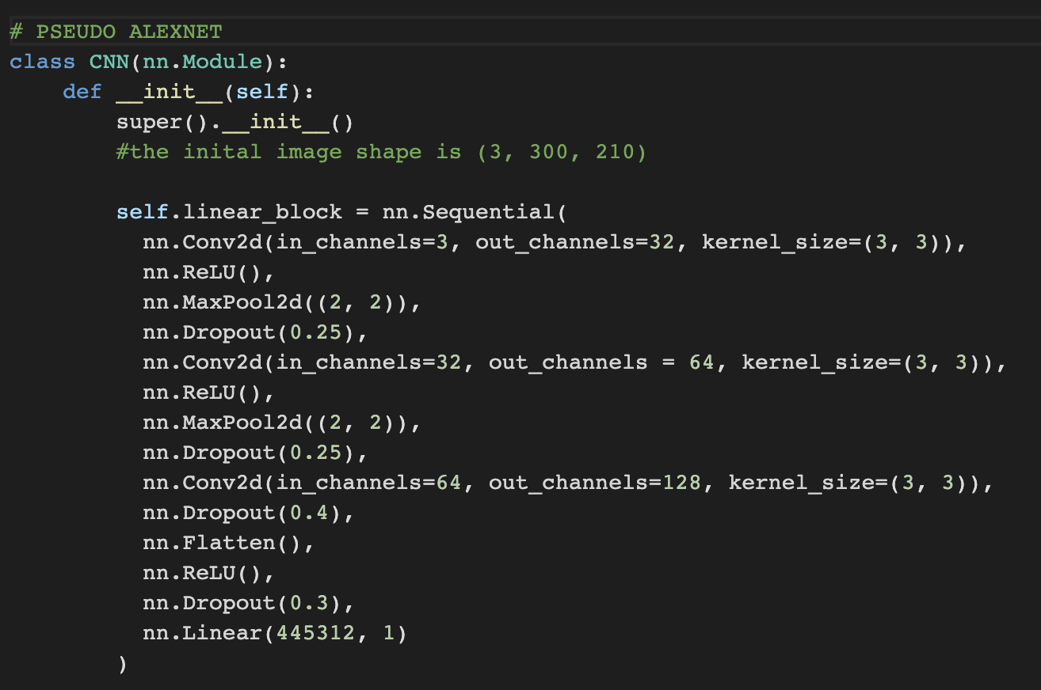
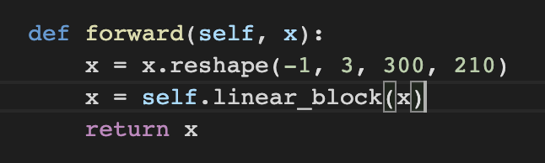
Step 1: Building Our Model
Notes:
Maanas
Our CNN network isnt powerful enough, which was originally 3 convolutions and 3 relu functions, was off by a factor of 1,000,000. When we switched to the Pseudo_Alex_Net, which 3 convolutions, 3 maxpools, 3 dropouts, we concluded that the newer network is better at extracting features. We think that there might be more minor transformations that we need to take into account as our network gets more robust and pwoerful over time

Slide 6

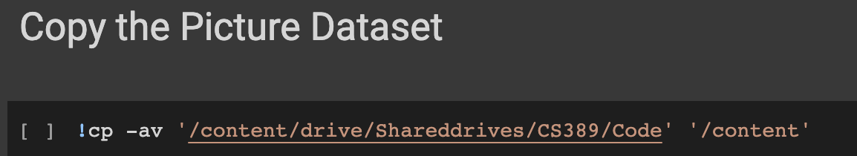
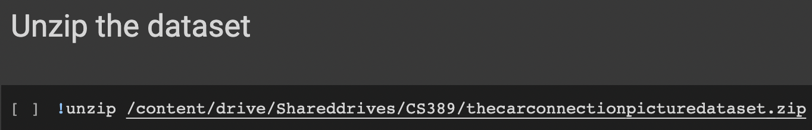
Stage 2: Loading Dataset, Seeding, Transformation
Notes:
Tirth
Seeding

Slide 7
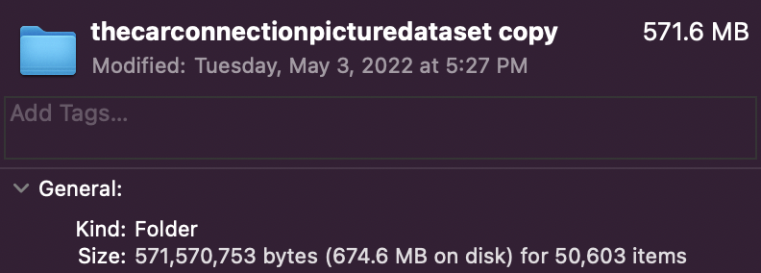
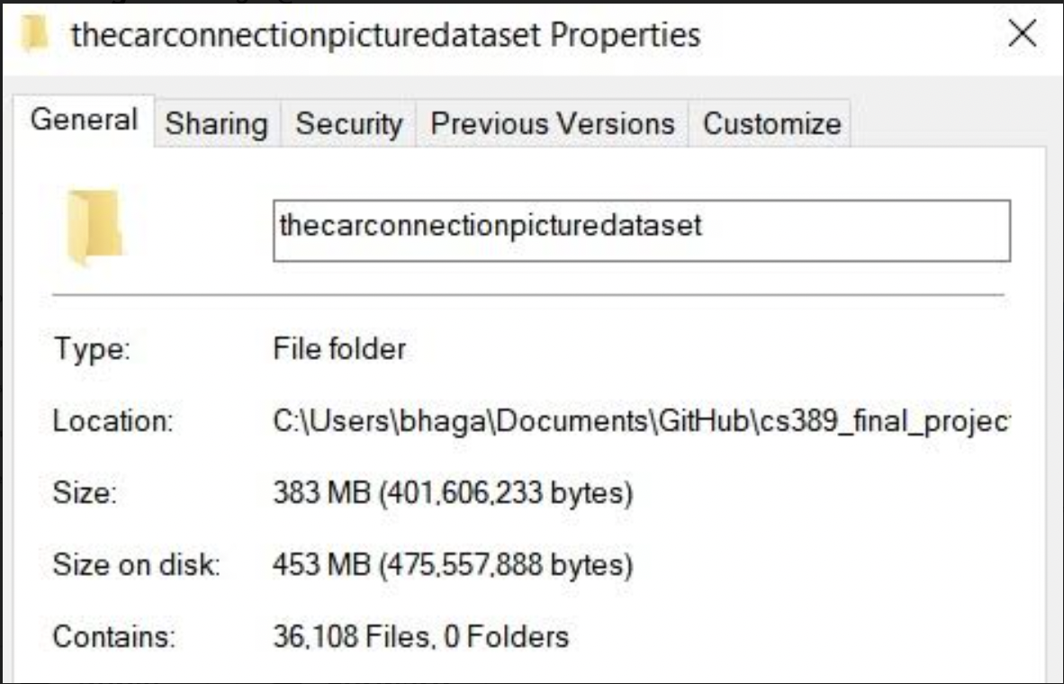
*60,000
Notes:
Maanas

Slide 8
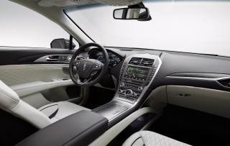
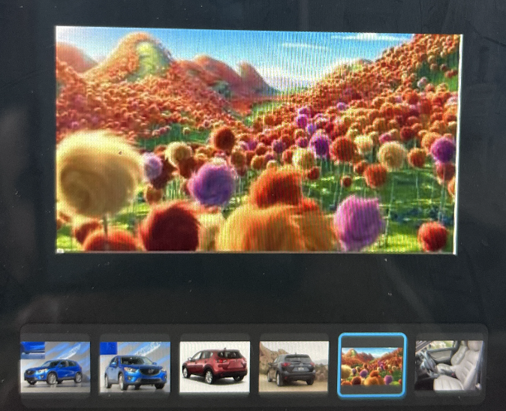

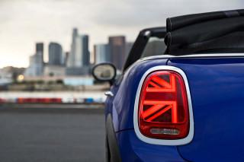
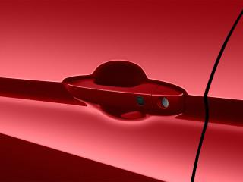
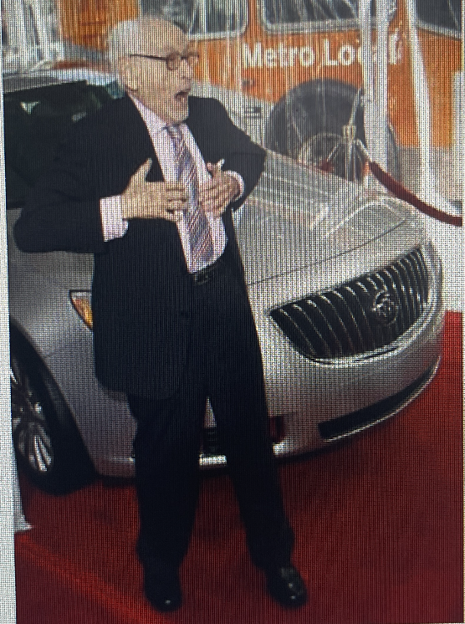
Notes:
Maanas
Some of these images dont have any relevant features while some of them are completely irrleevant

Slide 9
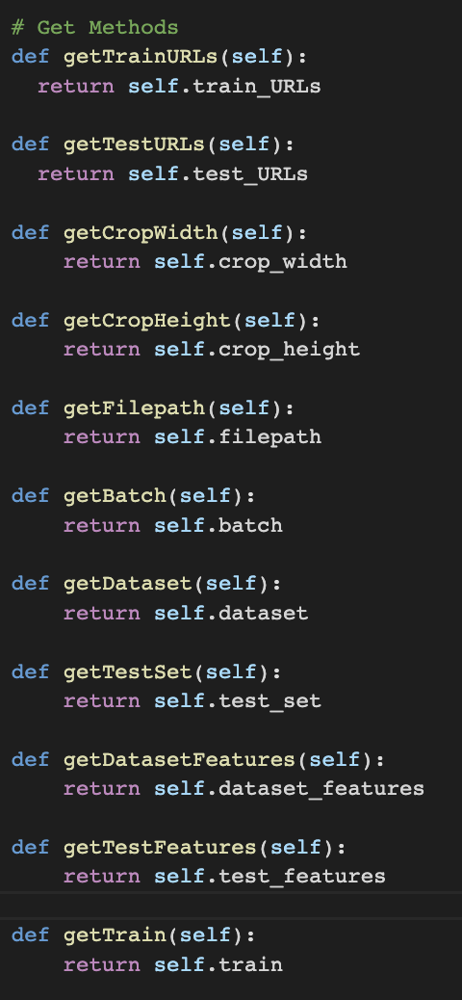
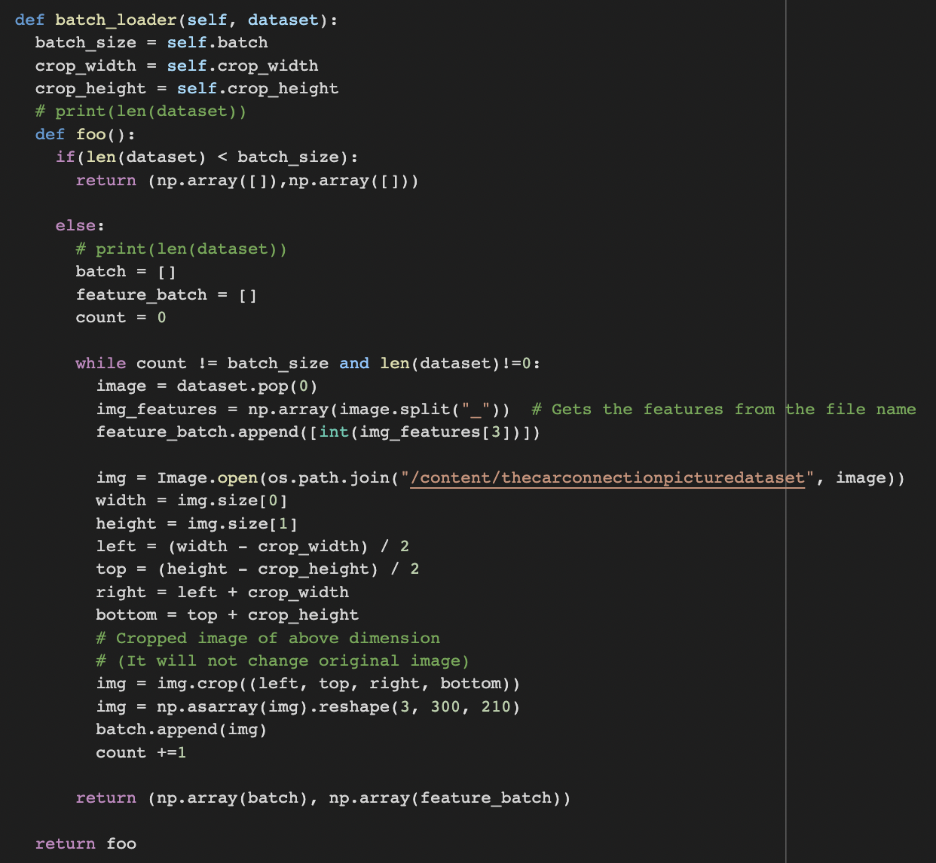
Notes:
Tirth

Slide 10
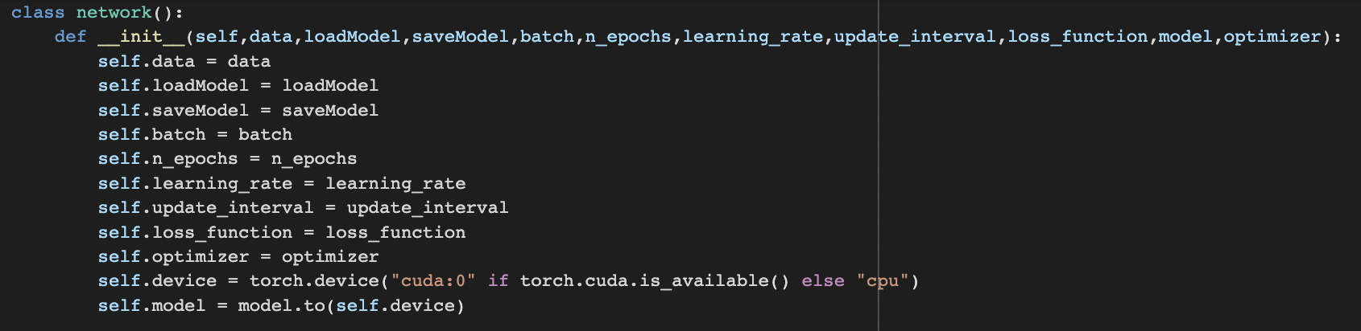
Step 3: Building Network
Notes:
Dylan

Slide 11
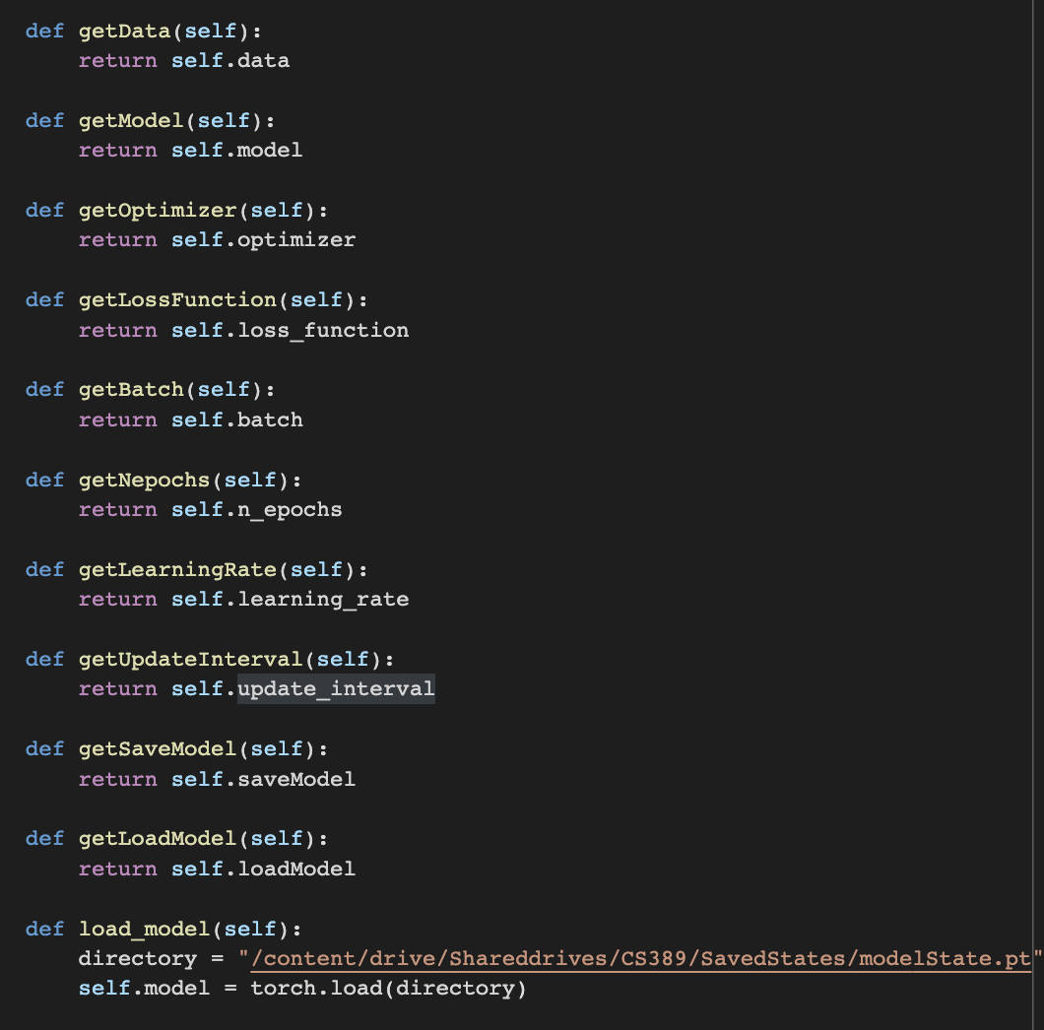
Notes:
Dylan

Slide 12
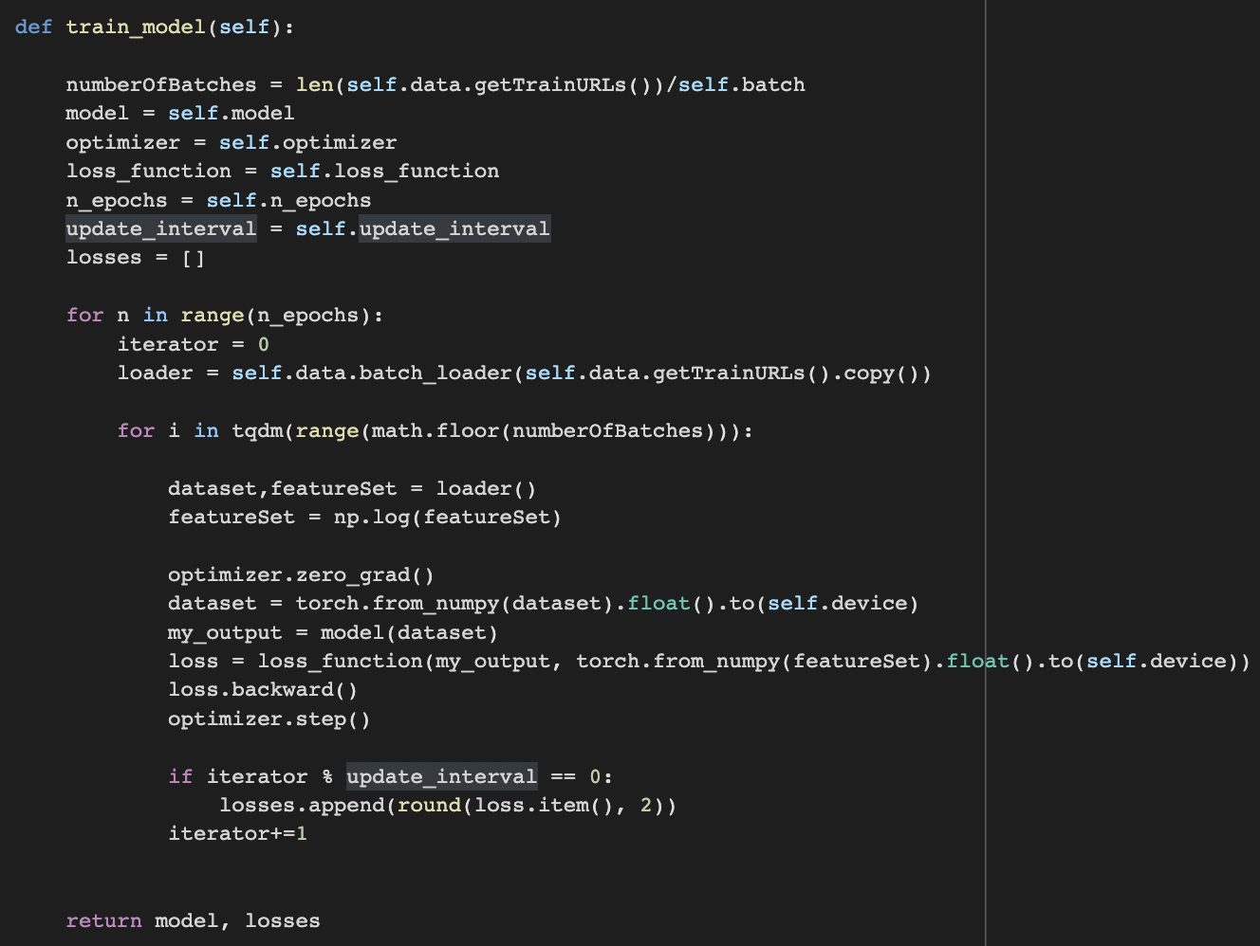
Notes:
Dylan

Slide 13
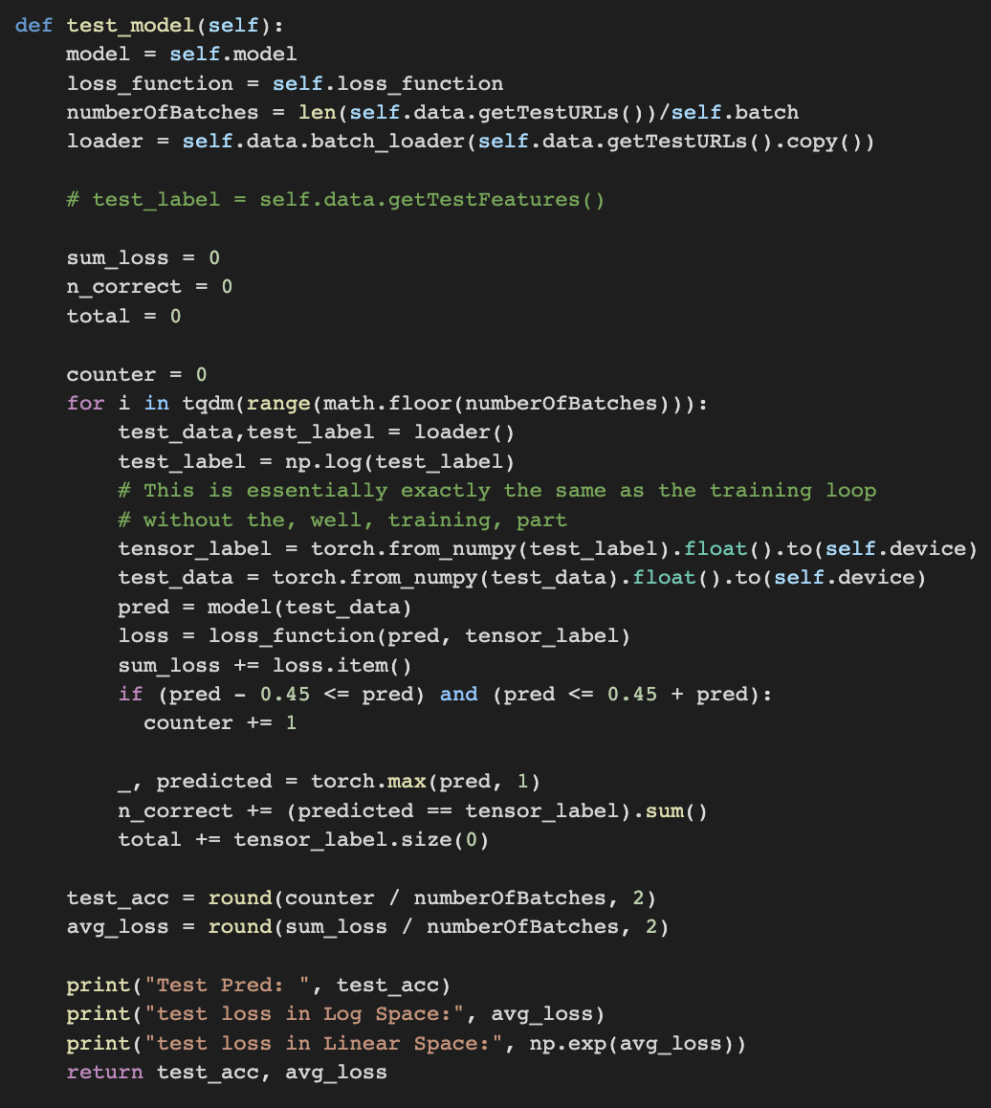
Notes:
Tirth

Slide 14
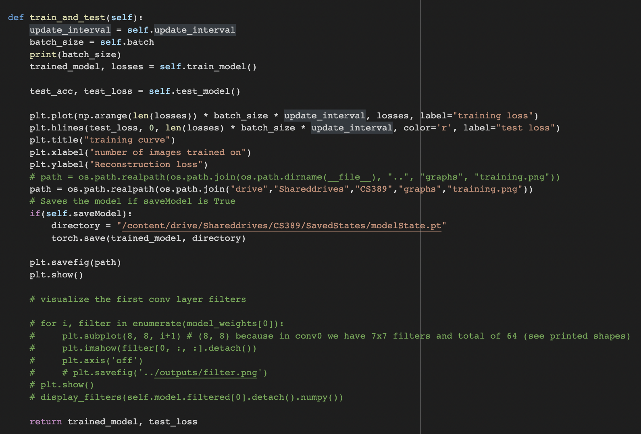
Notes:
Dylan

Slide 15
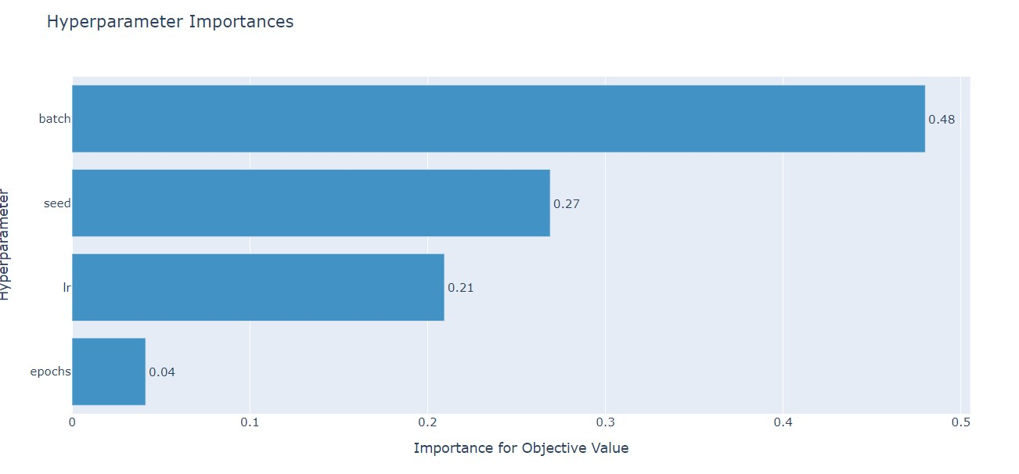
Step 4: Hyperparameter Testing
Notes:
Maanas

Slide 16
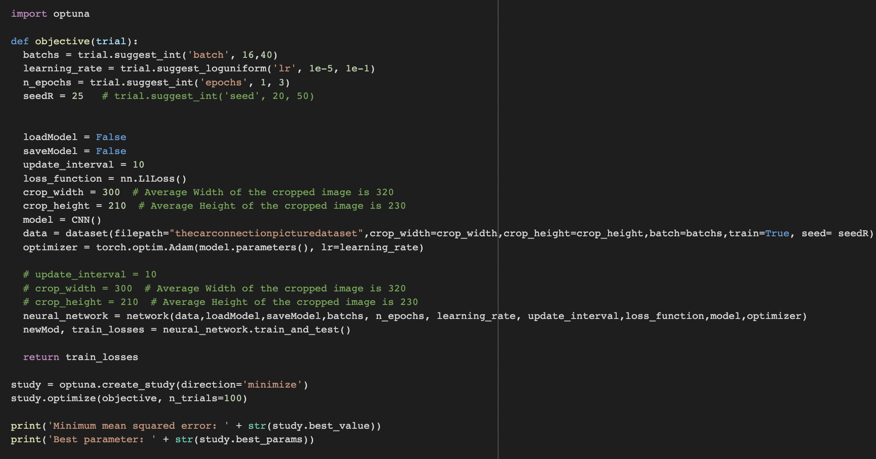
Notes:
Maanas

Slide 17
Notes:
Maanas

Slide 18
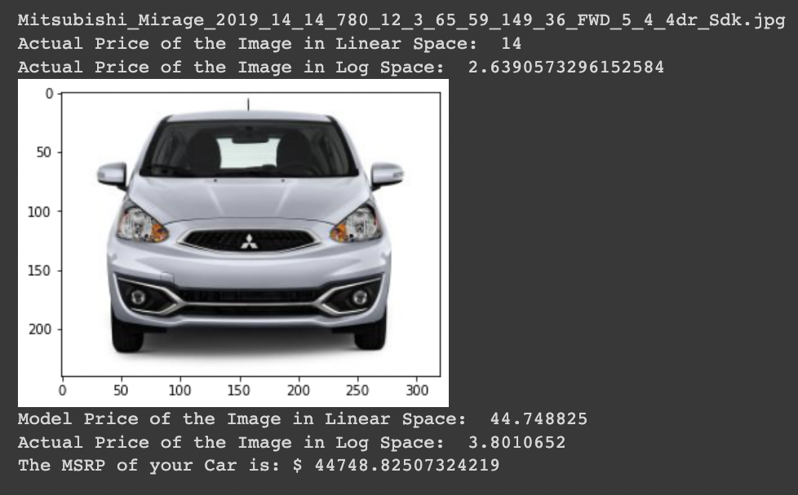
Step 5: Evaluating Results
Notes:
Dylan

Slide 19
Step 6: Making Changes

Slide 20
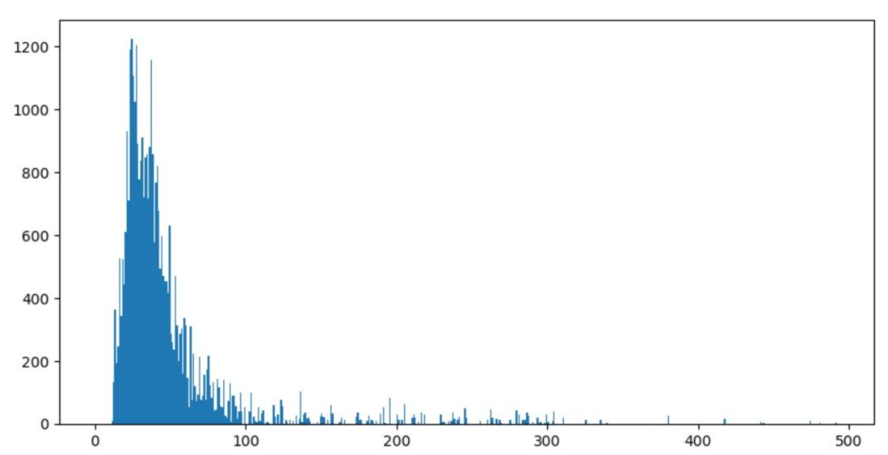
Notes:
Tirth

Slide 21
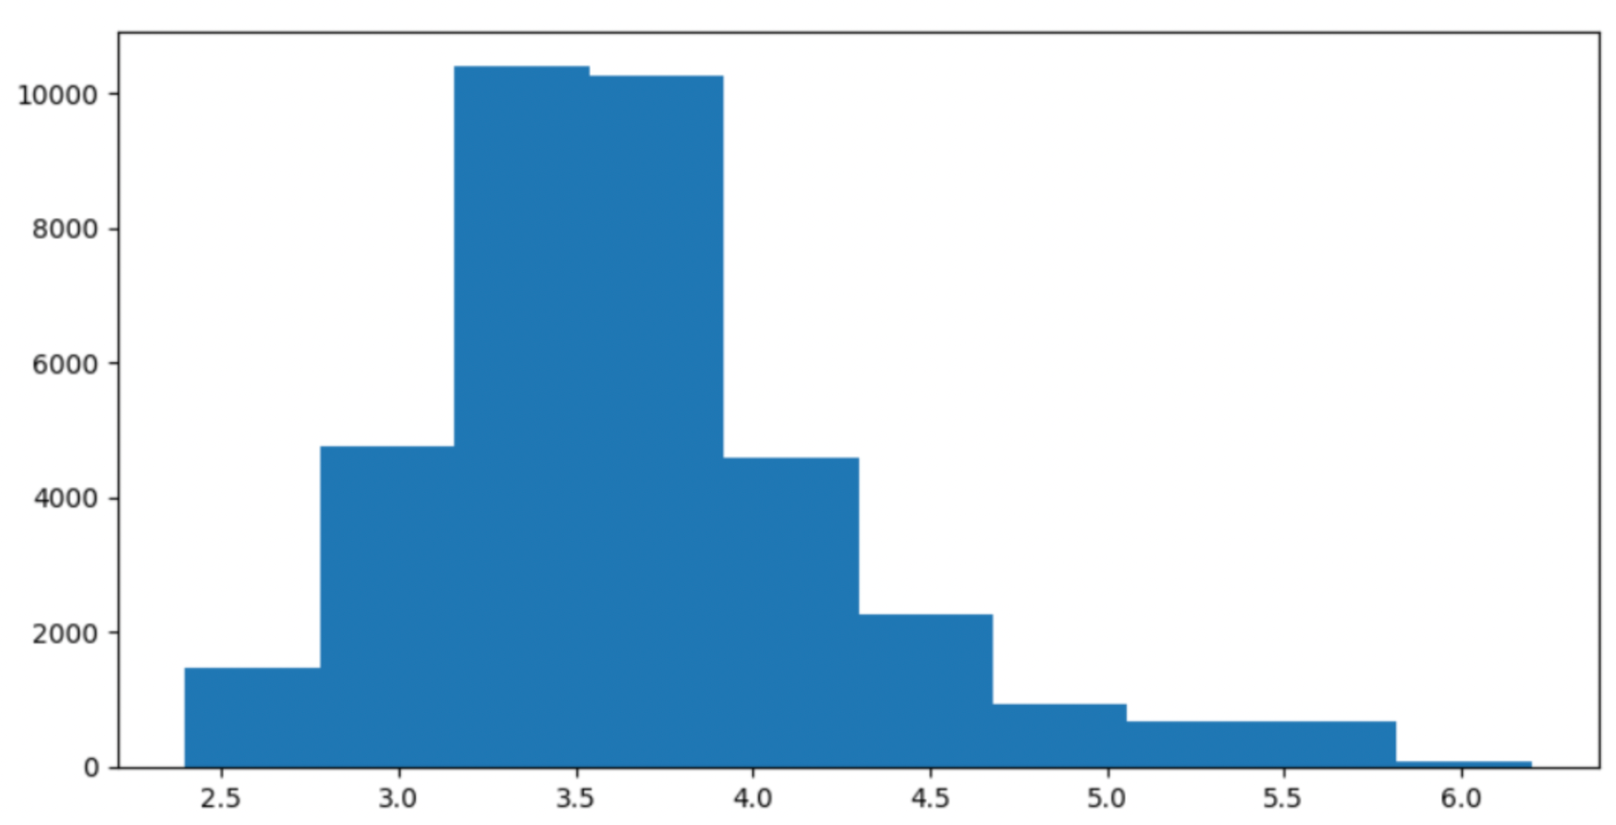
Notes:
TIrth

Slide 22
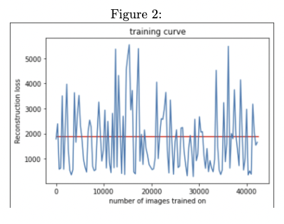
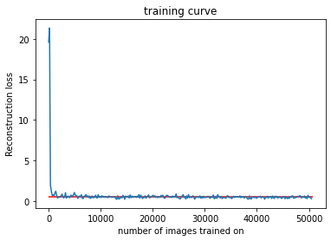
Result Explanations
Notes:
Tirth

Slide 23
Demo

